Slide 1

API Logging and Monitoring for Security Events
Enhance API security through real-time logging, monitoring, and alerting. This project aims to revolutionize incident response and threat detection in API ecosystems.

Slide 2

Project Overview
1
Objective
Develop a robust system for tracking and identifying API security incidents in real-time.
2
Key Features
Implement real-time logging, integrate monitoring tools, and set up automated alerts for suspicious activities.
3
Significance
Ensure proactive API security, minimize threat response time, and align with SIEM standards.

Slide 3
Existing System Challenges
Limited Visibility
Slow Incident Response
Minimal Automation
APIs often lack comprehensive logging, hindering effective security incident tracking and analysis.
Without real-time monitoring, identifying and responding to suspicious activities is significantly delayed.
Current setups frequently lack automated alerts, leading to delayed responses to potential security threats.

Slide 4

Proposed Solution
1
Real-Time Logging
Capture and analyze security-related events as they occur, providing immediate insights.
2
Integrated Monitoring
Utilize Prometheus and Grafana to visualize data, offering clear and actionable insights.
3
Automated Alerting
Configure alerts for specific risk events, notifying administrators instantly of potential threats.
4
SIEM Compliance
Adhere to Security Information and Event Management best practices for comprehensive security.

Slide 5
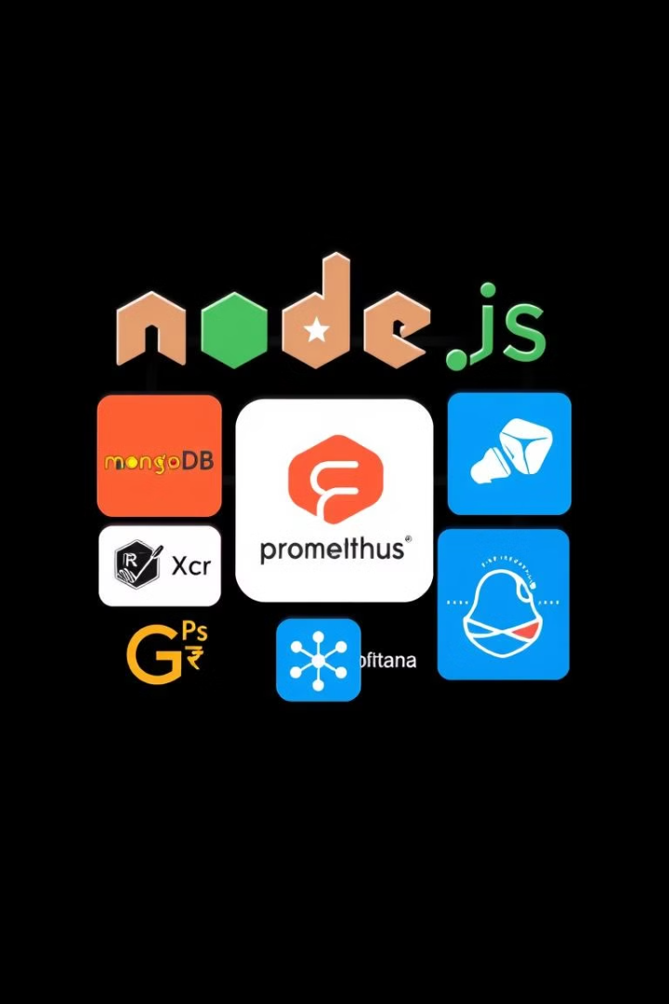




Technologies Involved
Backend
Node.js with Express for building and securing robust APIs.
Database
MongoDB or MySQL for efficient structured data and log storage.
Monitoring
Prometheus and Grafana for collecting metrics and visualizing real-time data.
Alerting
Configurable alerts integrated with email or Slack for instant notifications.

Slide 6
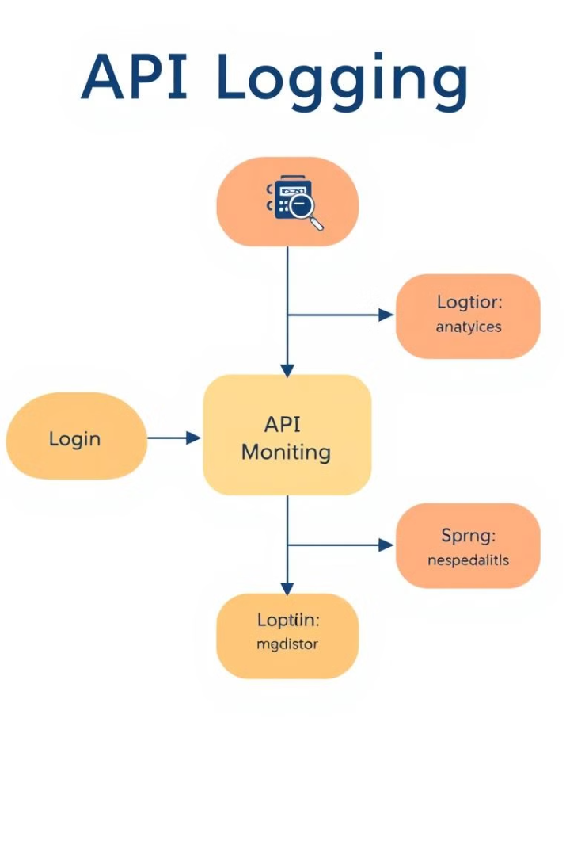




Project Architecture and Workflow
API Request Logging
API requests trigger event logging, capturing critical security-related information.
Data Storage and Analysis
Logs are stored in the database and analyzed by Prometheus for patterns.
Visualization
Grafana creates intuitive dashboards, offering real-time insights into API security status.
Alert Generation
Specific security events trigger alerts, promptly notifying administrators of potential threats.

Slide 7
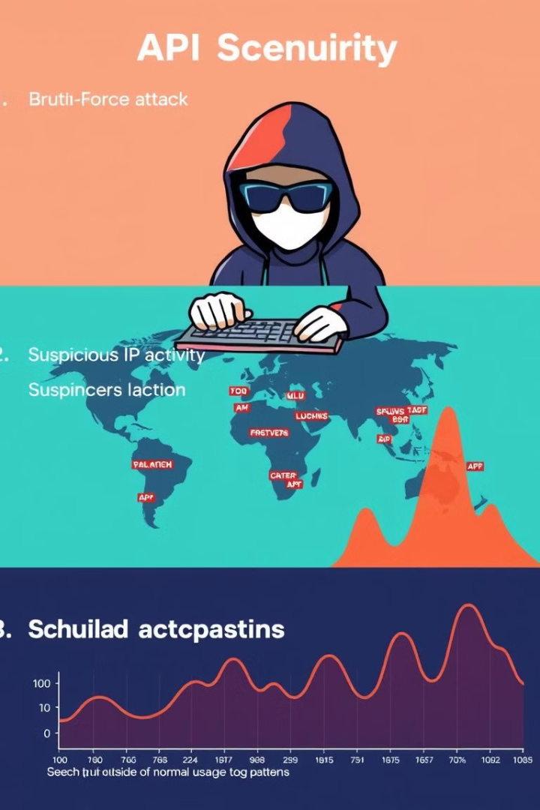
Use Case Scenarios
Scenario
Detection
Action
Failed Login Alert
Multiple failed attempts
Notify admin, block IP
Abnormal IP Activity
Unusual IP accessing API
Log for investigation
Access Pattern Analysis
Suspicious patterns detected
Flag and alert security team

Slide 8

Benefits and Impact
Enhanced Visibility
Rapid Response
Gain comprehensive insights into API activities, enabling proactive security measures.
Real-time monitoring and alerts significantly reduce incident response times.
Compliance Alignment
Operational Efficiency
Align with industry security standards, enhancing overall organizational security posture.
Automate security processes, allowing teams to focus on critical tasks.

Slide 9

Future Enhancements
Advanced Use Cases
AI-Powered Analysis
Expand monitoring and alerting capabilities to cover more sophisticated attack vectors.
Implement machine learning algorithms for predictive threat detection and automated response.
1
2
3
SIEM Integration
Integrate with enterprise SIEM tools for broader threat correlation and response.

